Slide 1
SMART WEATHER
WEATHER UPDATES MADE EASY

Slide 2
WEATHER APPS THESE DAYS
TURN ON WIFI/DATA
OPEN THE APP
POP UP ADS
TYPE THE ADDRESS
MORE ANNOYING ADS
WEATHER INFO

Slide 3
SYSTEM I DEVELOPED
Subscribe for Free using Text Messaging
Get Weather Info automatically every Morning
No Data Charges
No Ads
No Hassle

Slide 4
COMMANDS
SUBSCRIBE
UNSUBSCRIBE
CURRENT WEATHER
START (Address)
STOP
NOW (Address)

Slide 5
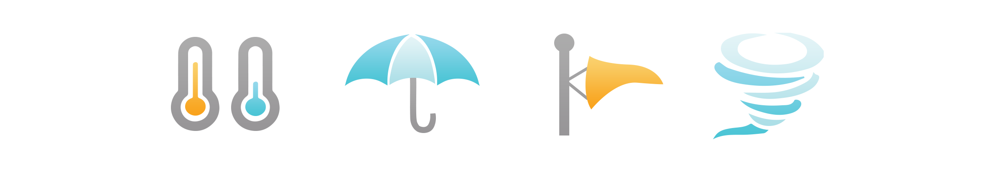
LETS TRY ONE
GET CURRENT WEATHER INFO OF WOODSTOCK WITH ZIPCODE 60001
TEXT “NOW 60001” to 571-317-2222

Slide 6



TECHNOLOGIES USED
Node.js Server
Twilio for SMS Communication
Open Weather Map API for Weather Data
Currently hosted in my laptop exposing port using “ngrok”

Slide 7
FUTURE PLAN
Use more phone numbers/multiple weather APIs to handle higher volume of subscription.
Allow users to subscribe weekly forecast, weather advisories etc.
Advertise extensively on social media, google ads to gain more subscribers.
Generate revenue by allowing companies to sponsor the text messages.
Weather in Mahwah (07430) is 66 degrees with clear sky. Maximum Temp: 78
Minimum Temp: 56
----- Weather Info sponsored by NY Pizza and Pasta, Ramsey, NJ (Now offering delivery options)
Weather Info
No Annoying Ads

Slide 8
QUESTIONS?
Thank You!

